Slide 1
A Comparative analysis between ANSI C and BaSeeCal
Proponents:
Caronongan, Arturo III
Choi, Edward
Chua, Kelvin

Slide 2
Introduction
C language
Designed in 1972 at the Bell Labs
Creator of C: Denis Ritchie
Based on B and BCPL languages
BaSeeCal language
Mixture of three programming languages
Visual Basic
ANSI C
Pascal

Slide 3
C vs BaSeeCal
Data Types
C
Primitive Types
int / long
float / double
char
boolean (expressed as an int or byte)
BaSeeCal
Similar in C
Does not have structures, double or long

Slide 4
C vs BaSeeCal
Strings
Sequence of characters grouped together under one data type
C
Not a primitive type
Array of characters
Memory Limit
BaSeeCal
Primitive type
Cannot treated as regular array

Slide 5
C vs BaSeeCal
Ordinal Types
Range of possible values can be easily associated with the set of positive integers
C
Uses enumeration or enum
BaSeeCal
Not supported

Slide 6
C vs BaSeeCal
Arrays
Homogenous structure of elements.
Initially filled with garbage data
Example: intlist [] = {4, 5, 7, 83}
Array size can be specified by
User
Dynamic Memory Allocation
free
malloc

Slide 7
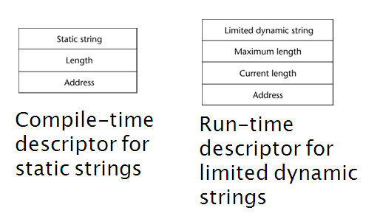
C vs BaSeeCal
Arrays
Two types of allocated arrays
Static
Compile-time descriptor for static strings
Dynamic
Run-time descriptor for limited dynamic strings

Slide 8
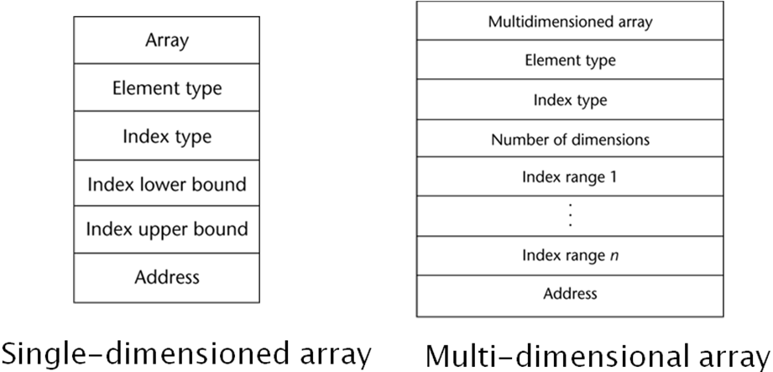
C vs BaSeeCal
Arrays
Single Dimensional
Multidimensional

Slide 9
C vs BaSeeCal
Arrays
C
user defined or dynamically allocated array size
Supports static and dynamic memory allocation
Single dimensional and multidimensional
BaSeeCal
User defined array size
Static memory allocation
Single Dimensional
Has set Array operation functions

Slide 10
C vs BaSeeCal
Unions
Variables are allowed to store different type values at different times during execution
C
Provides union constructs
BaSeeCal
Not supported

Slide 11
C vs BaSeeCal
Records
Heterogeneous aggregate of data elements
Several data types in a single structure
Records Implementation of C language

Slide 12
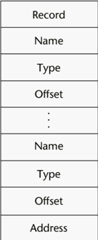
C vs BaSeeCal
Records
C
Using struct data type
Dot notation
BaSeeCal
Not Supported

Slide 13
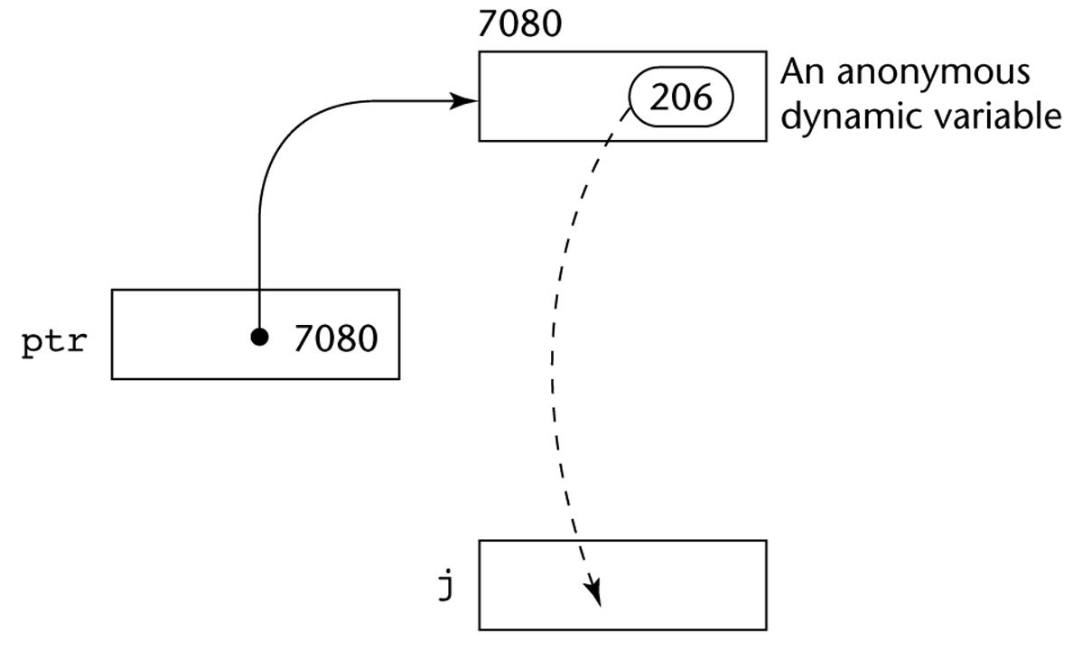
C vs BaSeeCal
Pointers
A range of values that consists of memory addresses and a special value, nil.
Pointers implementation in C

Slide 14
C vs BaSeeCal
Pointers
C
Dynamic storage management
Addressing when passing addresses as a reference of another variable
“Dangling Pointers”
BaSeeCal
Not Supported

Slide 15
C vs BaSeeCal
Files
Similar to Pointers: Refer to an address in the memory
Like strings (a special kind of pointer), it contains preset functions for the data type
fread()
fopen()
fseek()
fclose()

Slide 16
C vs BaSeeCal
Files
C Language
Treated as a memory address, like pointers
Has all the special functions stated
Able to read and write binary files
BaSeeCal
Treated as a structure, but not necessarily an address
Only able to write to text files
fwrite(),fopen(),fclose()

Slide 17
C vsBaSeeCal
Arithmetic Expressions
Made up of
Variable Names
Operators
Parenthesis
Operands
Evaluates by
Order of operator precedence
Infix to Postfix
Computes the values

Slide 18
C vsBaSeeCal
Arithmetic Expressions
Operator Precedence
Operator | Direction | Notes | C | BaSeeCal
(, ), [, ], ->, . | left to right | grouping | o | partly
!, ~, ++, --, -, +, (cast), *, &, sizeof | right to left | unary | o | partly
*, /, % ($ in BaSeeCal) | left to right | binary | o | o
+, - | left to right | binary | o | o
<<, >> | left to right | binary | o | x
<, <=, >, >= | left to right | binary | o | o
!=, == | left to right | binary | o | o
& | left to right | binary | o | x
^ | left to right | binary | o | x
| | left to right | binary | o | x
&& | left to right | binary | o | o
|| | left to right | binary | o | o
?: | right to left | ternary | o | x
=, += and combined assignment | right to left | binary | o | partly
, | left to right | binary | o | o

Slide 19
C vsBaSeeCal
Arithmetic Expressions
C
Compute the values and store to memory
Supports short-hand operators and overload operators
BaSeeCal
Uses data structure to store the values
Supports overload operators
Can catch impossible values like 1/0

Slide 20
C vs BaSeeCal
Assignment Statements
C and BaSeeCal
Simple assignments
Complex computations
Assignment as an expression
C
Short-hand operators
Unary operations

Slide 21
C vs BaSeeCal
Selection
Statements
ANSI C | BaSeeCal
if(<condition>) { <statement1> <statement2> … } | if(<condition>) { <statement1> <statement2> } endif;
if(<condition>) { <statement1> <statement2> … } else { <statement1> <statement2> … } | if(<condition>) { <statement1> <statement2> } else { <statement1> <statement2> } endif;
if(<condition>) <statement> | if(<condition>) { <statement1> } endif;

Slide 22
C vsBaSeeCal
Iterative statement | ANSI C | BaSeeCal
For loop | for(<assignment>; <condition>; <increment>) <statements> | for(<assignment>; <condition>; <increment>;) { <statement> … }
While | while(<condition>) <statements> | while(<condition>) { <statement> … }
Do while | do <statements> while(<condition>); | do_while(<condition>) { <statement> … }
Iterative
Statements

Slide 23
C vsBaSeeCal
Data Control
C Language
Pass-by-value
Pass-by-reference
Able to check validity of the parameters being passed (by bits)
Subprograms are not generic – Require a data type
Cannot override
BaSeeCal
Similar to C, but cannot Pass-by-reference
Also checks the validity of the parameters being passed (by data type)

Slide 24
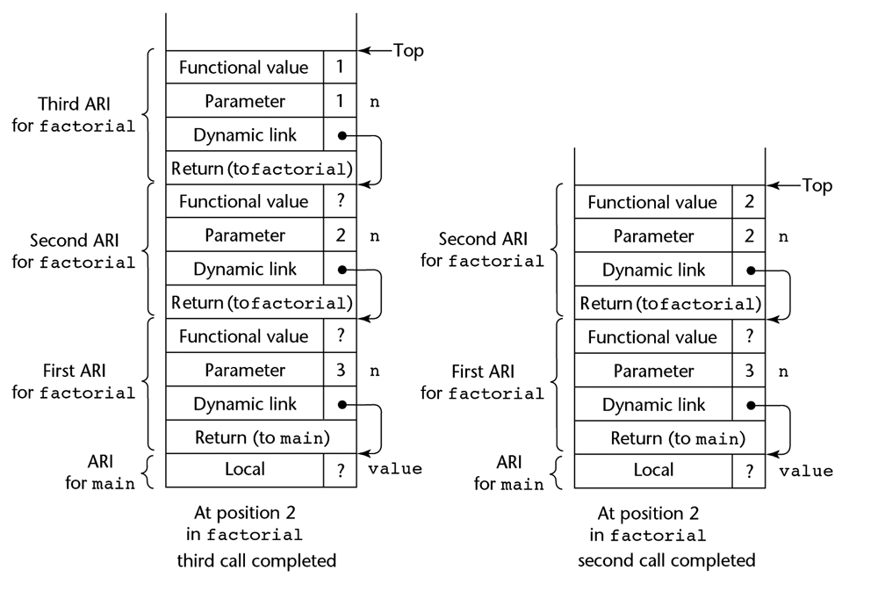
C vsBaSeeCal
Data Control
C Language
Stack Based
- Dynamic
BaSeeCal
Stack Based
- Dynamic

Slide 25
Language Evaluation Criteria
Readability
Orthogonality
Familiar Syntax
Understandable Keywords
Writability
Simplicity
Abstraction
Expressivity

Slide 26
Language Evaluation Criteria
Reliability
Type checking
Error checking
Exception Handling
Cost
Flexible
Executing time
Generality

Slide 27
Summary
Data Types | C | BaSeeCal
int | o | o
char | o | o
float | o | o
long | o | x
double | o | x
unsigned | o | x
Strings | o | o
Ordinal | o | x
Arrays | o | partly
Unions | o | x
Records | o | x
Pointers | o | x
Files | o | partly
C and BaSeeCal supports data types, sequence control and data control
Both languages met the criteria for
Easy to read and write the code
Reliable for Error checking
Generality where it can use wide range of applications.

Slide 28
Conclusion
Although both language met the criteria, C language proved to be more superior.
C is richer, more flexible, existed for longer duration and undergo several improvements

